Slide 1
Plug-in Development 201
Rich Client Applications
Chris Aniszczyk IBM Lotus, Austin

Slide 2
Tutorial Outline
The Rich Client Platform
Exercise Two: The Eclipse Browser Product
Fragments
Exercise Three: Internationalization
Q&A

Slide 3

Tutorial Outline
The Rich Client Platform
Exercise Two: The Eclipse Browser Product
Fragments
Exercise Three: Internationalization
Q&A

Slide 4
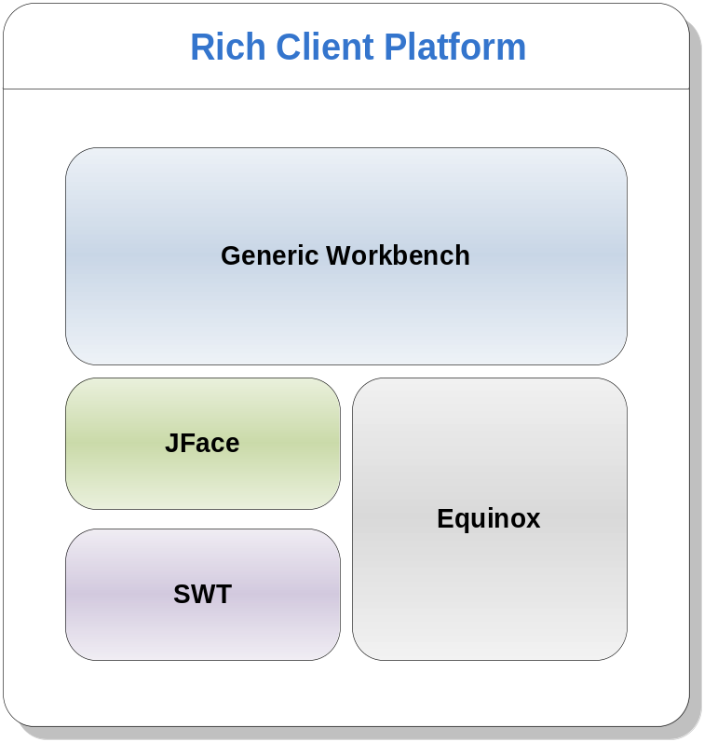
Rich Client Platform (RCP)
Equinox is the runtime
Standard Widget Toolkit (SWT) is a portable and native widget toolkit for Java
JFace is a framework for common UI programming tasks
Generic Workbench provides the UI personality of the Eclipse platform

Slide 5
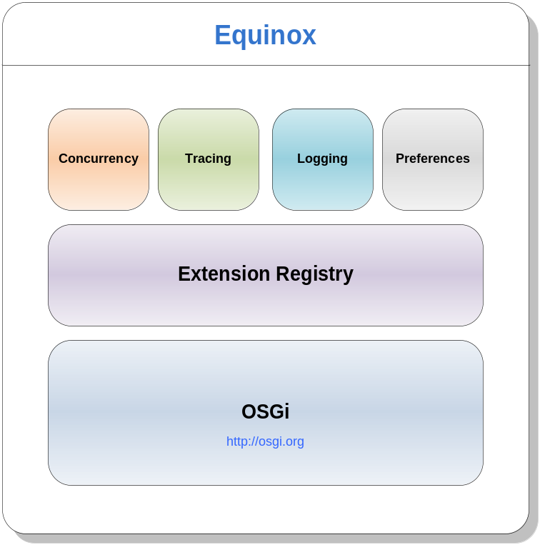
Equinox
OSGi is a framework that manages bundles
Plug-in == Bundle
The extension registry manages extensions and extension points
The concurrency infrastructure allows for running background jobs
Other runtime facilities include tracing, logging and preferences

Slide 6
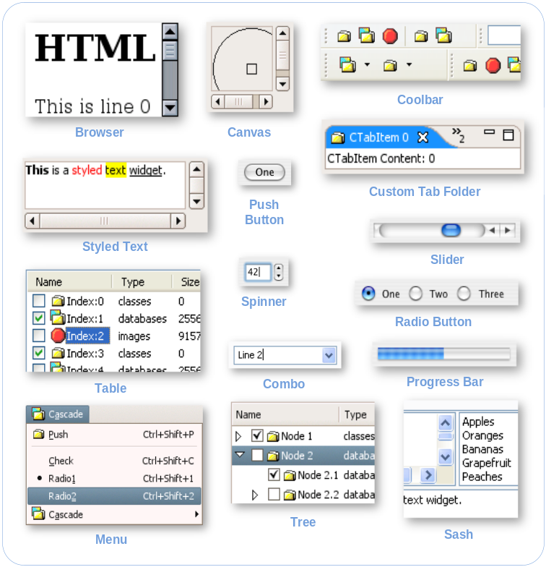
Standard Widget Toolkit (SWT)
SWT is a low-level graphics library that provides UI controls such as buttons, trees, combo boxes,…
SWT uses native widgets as much as possible
SWT has OS-independent API and is thus portable
SWT is independent of the Eclipse runtime

Slide 7
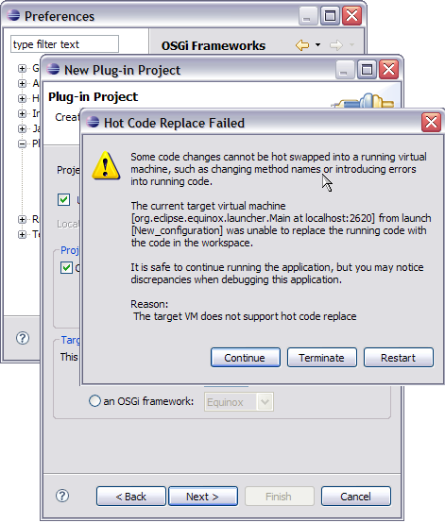
JFace
Built on top of SWT, JFace adds the model layer to the SWT widgets, e.g. tree viewers
JFace provides common UI constructs such as wizards and dialogs
JFace can be used standalone without the need for the Eclipse runtime

Slide 8
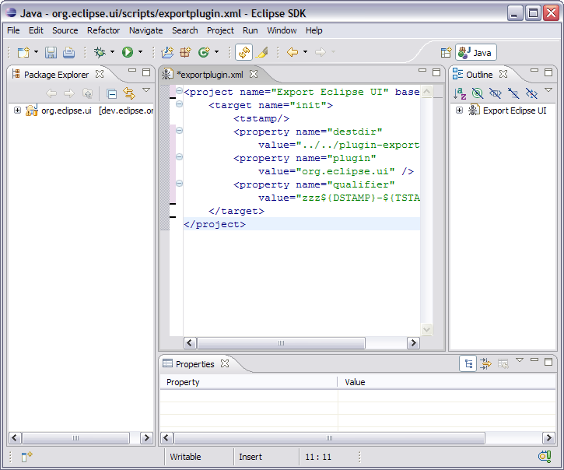
Generic Workbench
The Workbench defines common user-defined paradigms:
  Views, e.g. the Package Explorer
  Editors, e.g. the Java and plug-in manifest editors
  Perspectives: arrangement of views and editor

Slide 9
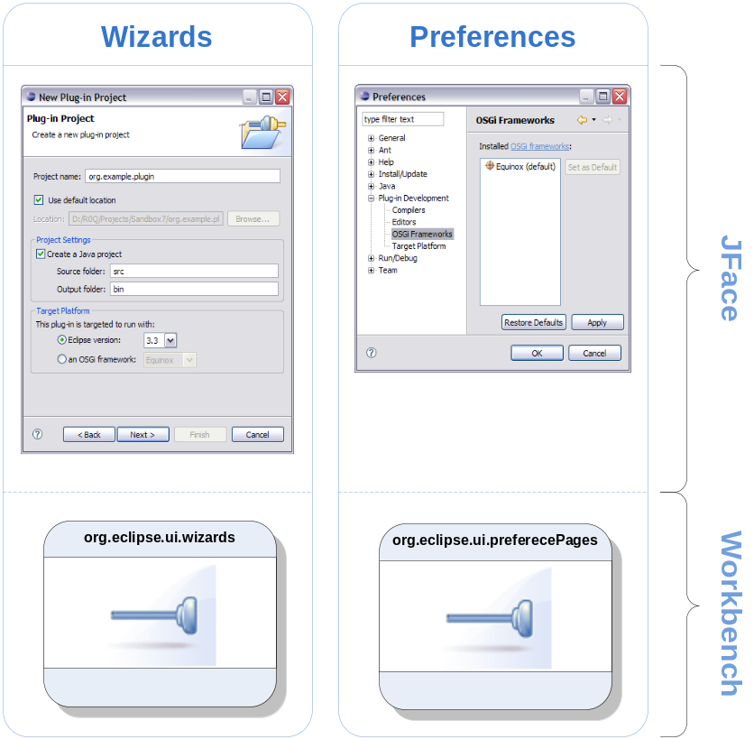
Contribution-Based Extensibility

Slide 10
Why Use Eclipse RCP?
An elegant plug-in architecture
Eclipse RCP does the middleware. You do your job.
From servers to embedded devices, RCP applications are portable
RCP applications provide a native user experience
JDT and PDE provide a first-class development environment

Slide 11
A Plug-in is a Plug-in is a Plug-in
Developing plug-ins for a rich client application is identical to writing plug-ins for the Eclipse SDK
Notable differences include:
  Target Platform
  Workbench configuration
  Defining an application
  Defining a product

Slide 12
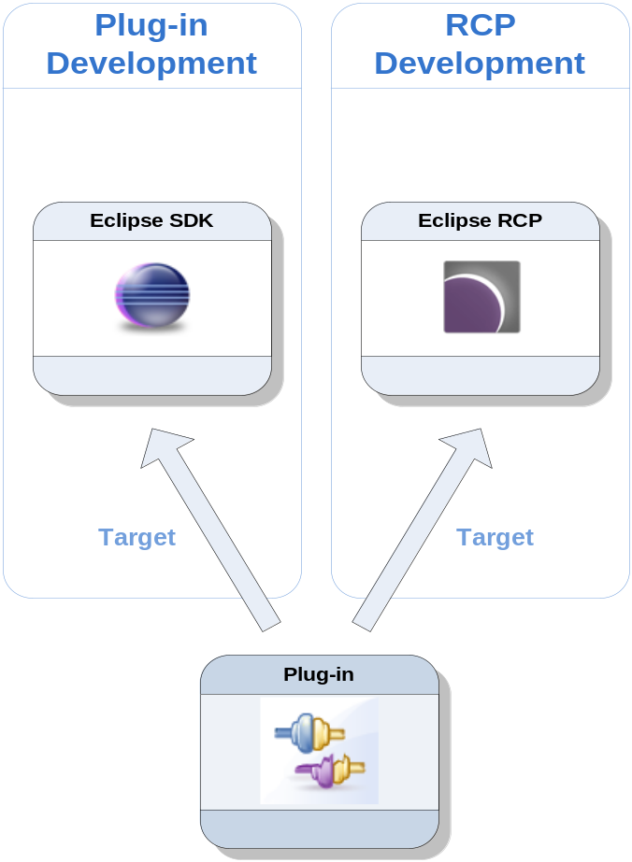
A Smaller Target

Slide 13
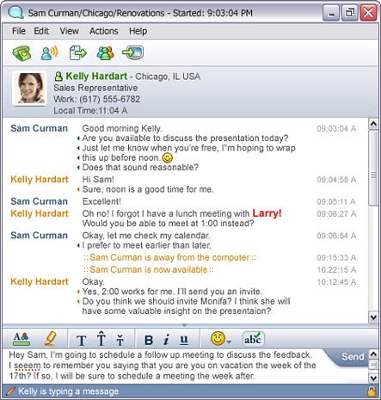
Customizing the Generic Workbench
When writing a plug-in for the SDK, you can extend (i.e. add) to the workbench, but you cannot remove or override
When writing an RCP application, you can configure every aspect of the workbench

Slide 14
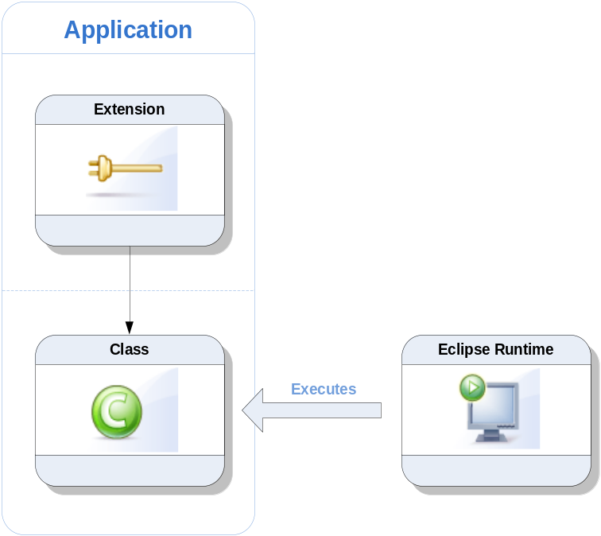
Applications
An application is to Eclipse what to the main() method is to a regular Java program
To run Eclipse, an application has to be specified
When you launch Eclipse, an application supplied by the IDE is run
In an RCP scenario, you supply your own application

Slide 15
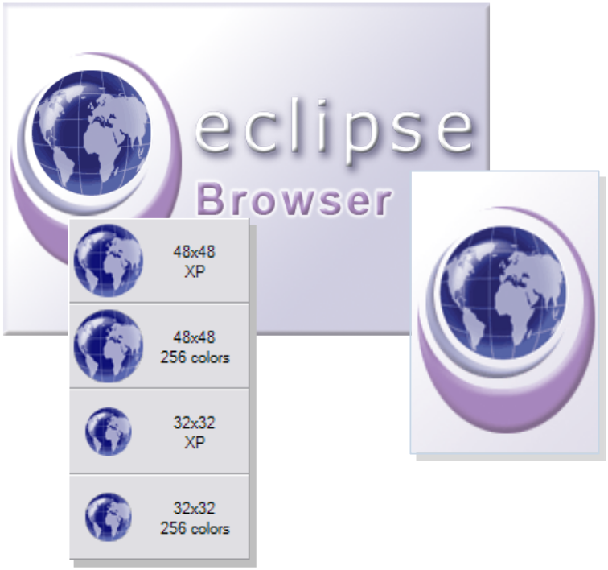
Products
A product is the Eclipse unit of branding
Branding gives the rich client application a personality
Branding encompasses window images, splash screen, a custom launcher
A product is defined declaratively as an Eclipse extension

Slide 16
Tutorial Outline
The Rich Client Platform
Exercise Two: The Eclipse Browser Product
Fragments
Exercise Three: Internationalization
Q&A

Slide 17

Exercise Two: The Eclipse Browser Product

Slide 18
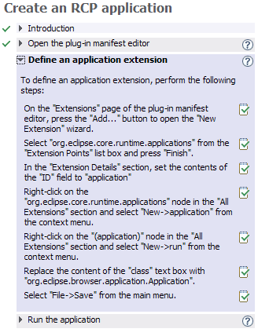
Part I: Create an Eclipse Application
This exercise is structured as a 3-step cheat sheet
You use the plug-in manifest editor to create an application extension
You launch the new application and you see that the same Browser view has seamlessly integrated into a different application

Slide 19
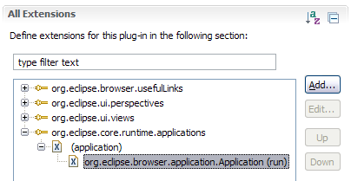
Define an Application Extension
An application is an org.eclipse.core.runtime.applications extension
It specifies a class which serves as the entry point to the application
For a typical UI application, the application creates, configures and runs a workbench
The application exits when the workbench exits

Slide 20
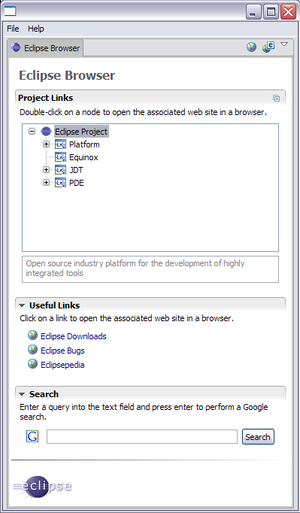
Eclipse Browser Application
The RCP application provides a standalone window with File and Help menus
The Browser plug-in integrates seamlessly with the application without any code changes
Don’t underestimate this minimalistic application. It can go toe-to-toe with any other RCP application. It is configurable, extensible, …

Slide 21
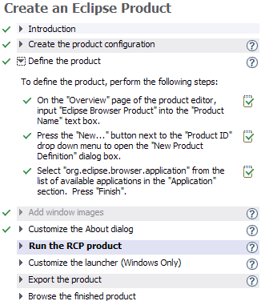
Part II: Create an Eclipse Product
This exercise is structured as a 8-step cheat sheet
You use the product editor to define every aspect of your product: launcher, window images, About Dialog
You export and run a fully-branded standalone product

Slide 22
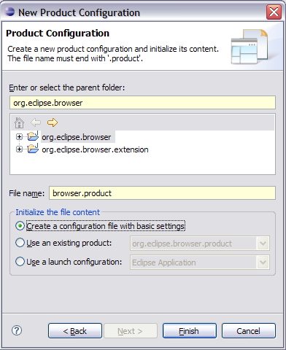
A New Product Configuration
A product configuration is the central place to manage all aspects of your product
A product configuration is used by PDE to define and assemble a product
A product configuration is neither read nor interpreted by the runtime

Slide 23
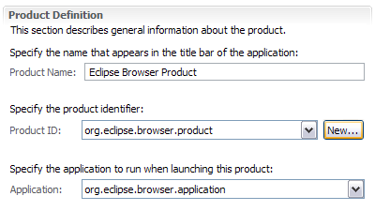
Product Definition
A product is associated with an application
A product provides branding and customization for the application
A product name appears in the title bar of the application
PDE uses this data to create an org.eclipse.core.runtime.products extension in the plug-in’s manifest file

Slide 24
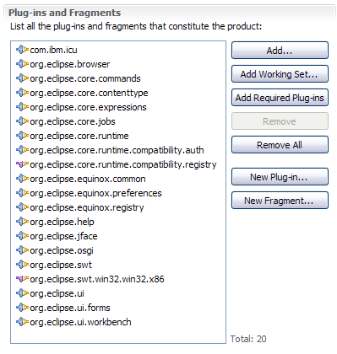
Building Blocks
A product must list all its constituent plug-ins. This list is only used by PDE to determine what to build and package
Plug-ins that are in source form in the workspace are compiled and packaged
Plug-ins that are already built (e.g. target plug-ins) are assembled as-is into the final product

Slide 25
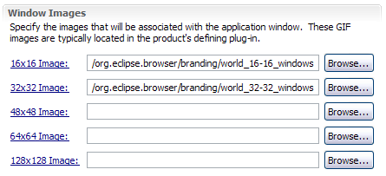
Window Images
Window Images are shown in the application window, task bar, … depending on the windowing system
On Windows, the 16x16 GIF image is used for the task bar and the 32x32 GIF is used in the Alt-Tab application switcher

Slide 26
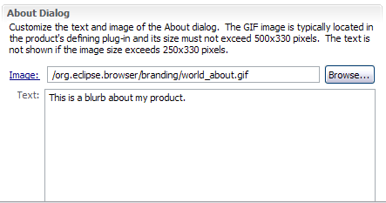
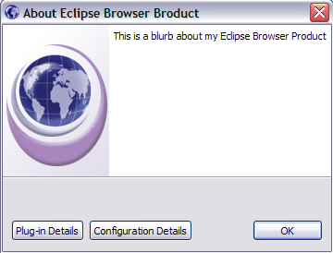
Customizing the About Dialog

Slide 27
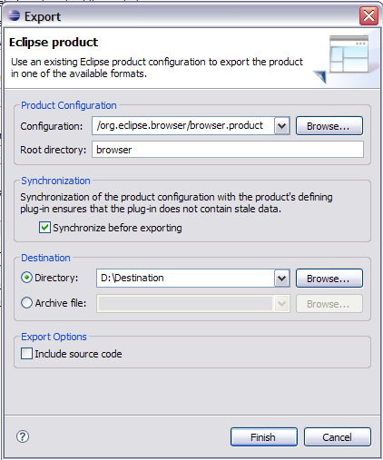
One-click Export
PDE provides a Product Export wizard that takes a product configuration file as input
The name of the root directory of the product is customizable
Options to export the product as a directory structure or an archive

Slide 28
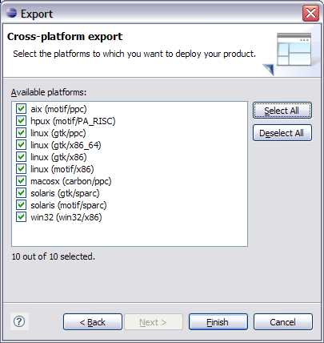
One-click Export to Multiple Platforms
The RCP delta pack is a separately downloaded archive that contains all OS-specific fragments and executables
When present, you are able to export your plug-ins to all supported platforms in a single step

Slide 29
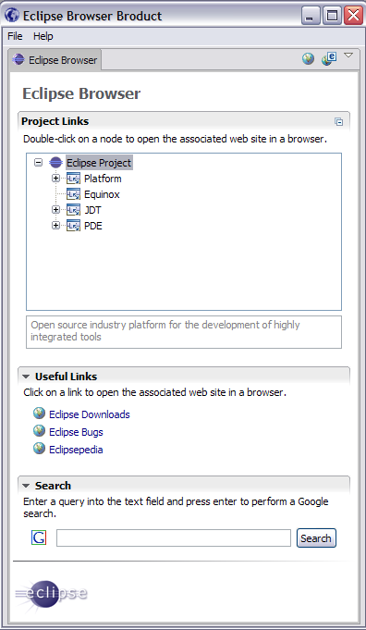


Slide 30
Tutorial Outline
The Rich Client Platform
Exercise Two: The Eclipse Browser Product
Fragments
Exercise Three: Internationalization
Q&A

Slide 31
Fragments
A fragment adds functionality to an existing plug-in (host)
  Content (extensions, code) is merged with the host content at runtime
  Fragments augment their host content. Fragments do NOT override.
Fragments typically house:
  Platform-specific content
  Locale-specific content: translation files
PDE provides a New Fragment Project creation wizard

Slide 32
How is a Fragment different from a Plug-in?
Fragments need a host to attach to
Fragments have no activator and no lifecycle
Dependencies cannot be expressed on a fragment
Fragments do not expose API
Extensions and extension points are contained in fragment.xml

Slide 33
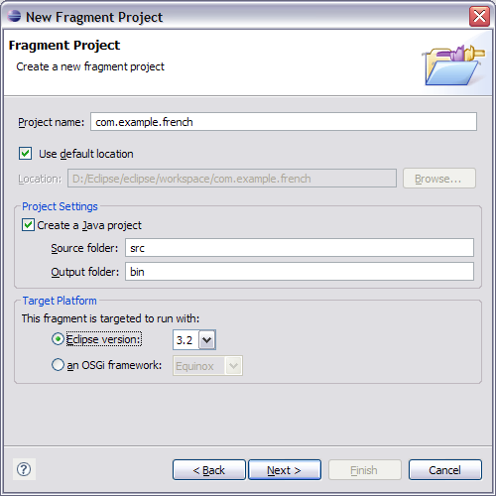
First Fragment – Step 1
The first page looks very familiar.
Same project settings as the one for a New Plug-in Project
Same naming conventions, etc.

Slide 34
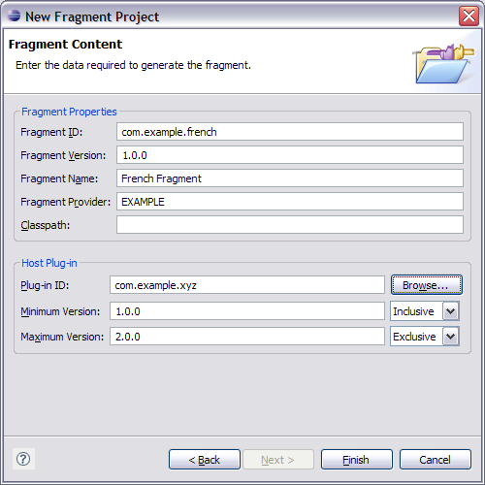
First Fragment – Step 2
We need the usual fragment ID, version, name, …
No Activator. Fragments have no lifecycle.
Specify the host to which the fragment will attach
The fragment will only be matched up with a host that matches the version range constraint

Slide 35
Tutorial Outline
The Rich Client Platform
Exercise Two: The Eclipse Browser Product
Fragments
Exercise Three: Internationalization
Q&A

Slide 36
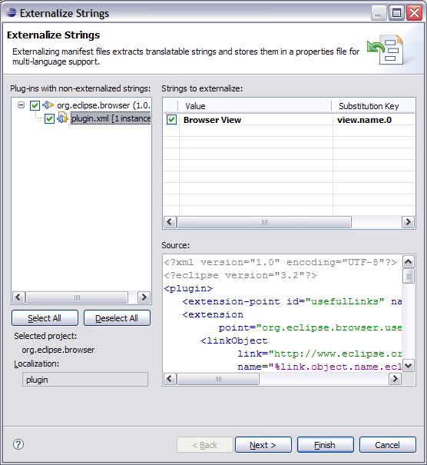
Externalizing Strings
Externalize strings so locale specific values can be substituted at runtime
JDT provides an externalization wizard for java code while PDE provides an externalization wizard for plug-in data

Slide 37
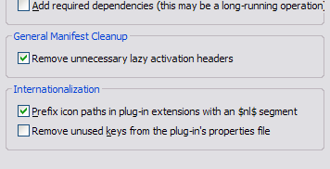
Add locale specific icons
The Organize Manifest wizard helps you to add the “$nl$” prefix to your icon paths which allows you to substitute custom icons based on locale

Slide 38
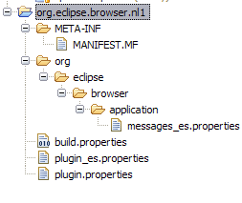
Language fragments
Language fragments contain locale specific values in properties files.
The properties files must follow the naming convention of “<host’s filename>_<locale>.properties”

Slide 39
Tutorial Outline
The Rich Client Platform
Exercise Two: The Eclipse Browser Product
Fragments
Exercise Three: Internationalization
Q&A

Slide 40
Questions and Answers?

Slide 41
Legal Notices
Java and all Java-based trademarks are trademarks of Sun Microsystems, Inc. in the United States, other countries, or both.
Linux is a registered trademark of Linus Torvalds in the United States, other countries, or both.
Microsoft, Windows, Windows NT, and the Windows logo are trademarks of Microsoft Corporation in the United States, other countries, or both.
IBM, Lotus, Rational are copyrights of IBM Corporation in the United States, other countries, or both.
Other company, product, or service names may be trademarks or service marks of others.

